Slide 1
Options trading activity
and firm valuation
Journal of Financial Economics
Richard Roll
Eduardo Schwartz
Avanidhar Subrahmanyam

Slide 2
How contingent claims affect markets for the underlying assets?
Completing markets: simple options are powerful abettors of efficiency in competitive equilibrium.
Improving informational efficiency: Alter the incentives to trade on private information about the underlying

Slide 3

CONTENT
1
Introduction
Motivations of the paper
2
Methodology
Variables, and Econometrics
3
Data
Sample data
4
Empirical analysis
Base regression results, robustness check, & further analysis
5
Conclusion
Conclusion on the empirical findings
6
Contributions
Contirbution to existing literature, & further research questions

Slide 4
INTRODUction
Options trading activity and Tobin’s q (firm value)
- Valuation benefit from options to a firm should depend on trading activity
2) Options trading and information production
- The effect of options activity on valuations obtains by way of options’ effects on information production

Slide 5
Method0logy
Variables
Econometrics
Dependent variable
Tobin’s q
Regression model:
Cross-sectional
Check serial correlation:
T-statistics corrected according to the procedure of Newey and West (1987)
Regressors
Main predictor:
Options Trading Volume
Controls
Size
Share turnover
ROA
Capex
LTD
Dividend dummy
Robustness check:
Panel regression
Lag in options trading
Logarithm of options trading
Time fixed effetcs
Industry fixed effects

Slide 6
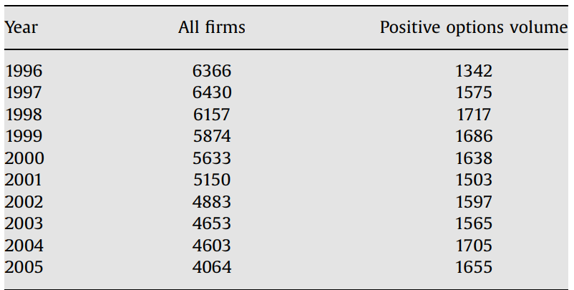
dATA
OptionMetrics LLC
Compustat
Options trading data
Tobin’s q & control variables
Sample size of firms from 1996 to 2005

Slide 7
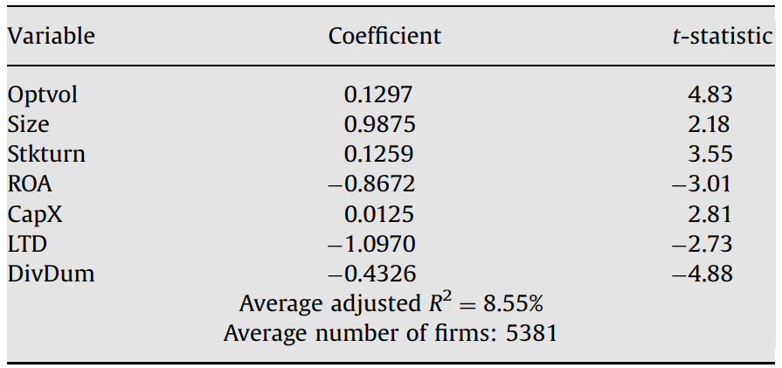
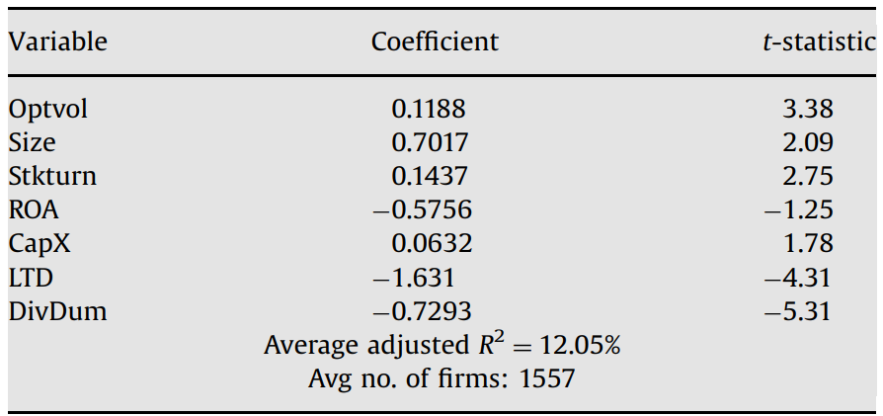
Empirical analysis
(I)
Base case- Cross sectional regression
1) Full sample
all the firms in the sample
2) Subsamples
firms with positive options volume
Effect of options trading on firm valuation (TOBIN’S q) is both statistically and economically significant.

Slide 8
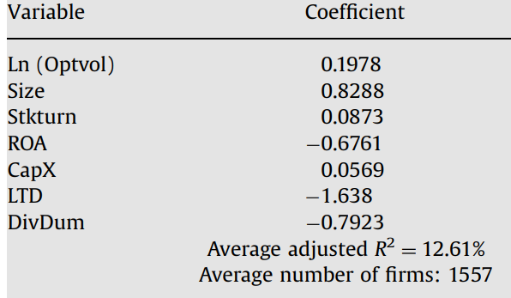
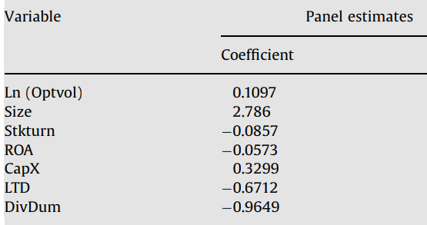
Empirical analysis
1) Log options volume
2) Panel regression
(II)
Robustness
checks

Slide 9
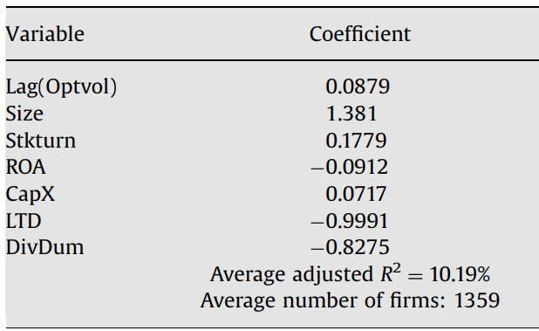
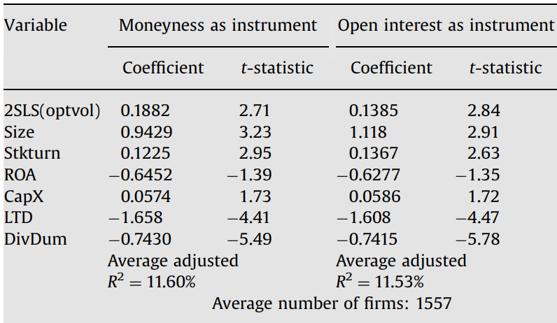
Empirical analysis
3) Endogeneity
(II)
Robustness
checks
One-year lagged options volume
Two instruments for options volume that are unrelated to Tobin’s q

Slide 10
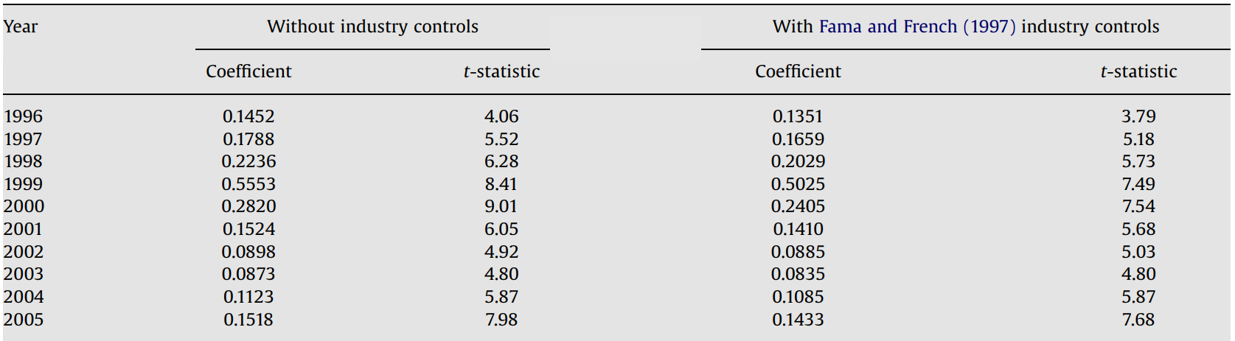
Empirical analysis
4) Year-by-year regression coefficients and industry controls
(II)
Robustness
checks

Slide 11
Empirical analysis
(III)
Options trading & information production
The interaction of q with options volume is strongly significant, indicating a greater sensitivity of investment to stock price when options trading activity is high.
Options trading contributes to information production, which managers use in making corporate investment decisions
A direct measure
of information asymmetry
It is also possible that options volume proxies for another measure of information production, the extent of analyst following.
Options activity increases firm values by way of its impact on information production, and that security analysts substitute for private information trading by generating public information signals.
Options volume variable remains significant in every year, and the interaction of the options volume with PIN (probability of informed trading, proxy for information asymmetry) is always positive.
The effect of options volume on q is stronger in stocks where more information is produced by the trading process
Options trading and firm profitability
Firms with greater levels of past options volume tend to be more profitable in the future.
Options trading can lead to better corporate resource allocation by increasing price efficiency.
Options trading and investment sensitivity to stock price
Security analysts and options trading

Slide 12
Conclusion
Options trading contributes to firm value
Consistent- inclusion of a host of control
Consistent-
for robustness checks
Value increases with options trading volume,
&
it is partly linked to increased information production in actively traded markets
Results are consistent after controlling for other variables that contribute to firm value:
Size
Share turnover
ROA
Capex
LTD
Dividend dummy
Results are consistent for various robustness check:
Log options volume
Panel regression
Endogeneity
Year-to-year regression and industry controls

Slide 13
Contribution…
…to existing literature:
Benefits of options listing.
If prices convey more information, corporate resources are allocated more efficiently, and this leads to greater firm valuation.
…to the scope for further research:
Since options trading activity has valuation effect, it would be interesting to check if this scenario is present for other derivatives products such as futures contracts.

Slide 14
THANKS
FOR YOUR
ATTENTION

